Slide 1
Capstone Project NLP
Farouk Abdel-Magied

Slide 2
Motivation and Dataset

Slide 3
IMDb “Top 100” – Web scraping

Slide 4
IMDb Plot + Wiki Plot(not scraped)
Dataset
Motivation: Apply NLP concepts to convey and draw information from the scraped/collected plot data .

Slide 5
Preprocessing

Slide 6
Tokenization – Preprocessing(1/4)
What is Tokenization?
Tokenization is simply a form of data preprocessing that is applied on the text dataset before applying any machine/deep learning algorithm.
Steps:
Split the text document into sentences
Split each sentence into words or punctuation
Why is this important?
This process is important to allow the future transformation of strings into numerical data to be used in a model.

Slide 7
Tokenization – Example
Figure (1)
Figure (2)

Slide 8
Stemming – Preprocessing(2/4)
What is Stemming?
Stemming is the process of transforming the original words into their root structure based on their meaning, to avoid lexical differences in words with the same meaning.
Figure (3)
Figure (4)

Slide 9
Stopwords – Preprocessing(3/4)
Removing Stopwords:
The final stage of the text preprocessing section is removing stopwords.
Stopwords are basically words that do not add much meaning to a sentence.
Figure (5)

Slide 10
Application to Data - Preprocessing(4/4)
Blackbox
Tokenization
List of 184291 of stemmed words that are free of Stopwords
Movie Plots Combined
Stemming
Input
Output
Stopwords

Slide 11
Preprocessing Output

Slide 12
Wordcloud – Preprocessing Output(1/2)

Slide 13
Most Common Words - Preprocessing Output(2/2)

Slide 14
Modelling/Measuring Text Similarity

Slide 15
CountVectorizor - Transforming Text to Numerical Data(1/3)
Figure (6)
Figure (7)

Slide 16
TF-IDF - Transforming Text to Numerical Data(2/3)
Figure (8)

Slide 17
Cosine Similarity - Transforming Text to Numerical Data(3/3)
Cosine similarity:
A metric used to measure how similar the documents are irrespective of their size.
Figure (9)

Slide 18
Text Similarity Application
TF-IDF
Similarity Distance
$$Similarity Distance=1−Cosine Similarity$$

Slide 19
Hierarchical Clustering Dendrogram

Slide 20
Text Output Analysis - Hierarchical Clustering(1/7)
Dendrogram

Slide 21
Text Output Analysis - Hierarchical Clustering(2/7)
COMEDY | DRAMA
BIOGRAPHY | HISTORY | DRAMA

Slide 22
Text Output Analysis - Hierarchical Clustering(3/7)
MYSTERY | THRILLER
CRIME | WAR | DRAMA

Slide 23
Text Output Analysis - Hierarchical Clustering(4/7)
ADVENTURE | WAR | DRAMA
ROMANCE | DRAMA

Slide 24
Text Output Analysis - Hierarchical Clustering(5/7)
CRIME | SCI-FI | ADVENTURE
ROMANCE | DRAMA

Slide 25
Text Output Analysis - Hierarchical Clustering(6/7)
WESTERN | DRAMA

Slide 26
Text Output Analysis - Hierarchical Clustering(7/7)
BIOGRAPHY | HISTORY | DRAMA
ROMANCE | DRAMA
MYSTERY | THRILLER
ADVENTURE | WAR | DRAMA
CRIME | SCI-FI | ADVENTURE
WESTERN | DRAMA
COMEDY | DRAMA
CRIME | WAR | DRAMA
ROMANCE | DRAMA

Slide 27
K-Means Clustering

Slide 28
Text Output Analysis – K-Means Clustering(1/6)

Slide 29
Text Output Analysis – K-Means Clustering(2/6)
Cluster = 0
DRAMA | FANTASY | ROMANCE

Slide 30
Text Output Analysis – K-Means Clustering(3/6)
Cluster = 1
DRAMA | WESTERN |BIOGRAPHY

Slide 31
Text Output Analysis – K-Means Clustering(4/6)
Cluster = 2
DRAMA | WAR |ADVENTURE

Slide 32
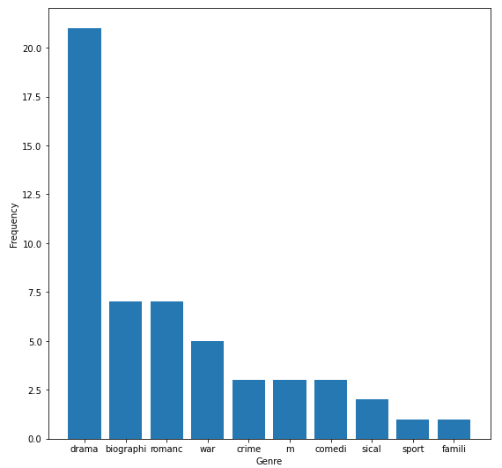
Text Output Analysis – K-Means Clustering(5/6)
Cluster = 3
DRAMA | BIOGRAPHY |ROMANCE

Slide 33
Text Output Analysis – K-Means Clustering(6/6)
Cluster = 4
DRAMA | ROMANCE |THRILLER

Slide 34
LDA Application

Slide 35
Extracted Topics – LDA Output
LDA Coherence Analysis:
3 topics is the ultimate value to represent the range of topics to be extracted from the documents.
Extracted Topics:

Slide 36
Topic 0 – LDA Output
Brother
Son
Years
Extracted Themes:
Family + Romance
Family
Topic 0
Love
Day
Children
Father

Slide 37
Topic 1 – LDA Output
Tries
Goes
Woman
Extracted Themes:
Mystery + Thriller
Police
Topic 1
Room
Car
Apartment
House

Slide 38
Topic 2 – LDA Output
Attack
Battle
Soldiers
Extracted Themes:
War + Crime
Men
Topic 2
Captain
War
Killed
Army

Slide 39
Conclusion
World Life Scenario:
Don’t know that the supplied data belongs to movie plots
Final NLP output:
Extracted themes:
Family
Romance
Mystery
War
Crime
These look like movie Genres

Slide 40
Questions and GitHub link
Any Questions?
GitHub repository link:
https://github.com/faroukabdelmagied/NYCDSA_Capstone_NLP_Project

